Slide 1
Industrial engineerng
PRODUCTIVITY

Slide 2
Production
Production is the process by which raw materials and other inputs are converted into finished products. Production is the backbone of a nation’s economic progress.

Slide 3
Productivity
Productivity is the efficiency of the production system,which is expressed by the ratio between output and input.
            Quantity of goods and service produced
Productivity= -------------------------------------
            Amount of resource used

Slide 4
Benefits from Productivity
For Management:
(i)More profit earning
(ii)Increase in market share.
(iii) better utilization of resources
2.For Worker:
Better carrier prospects
Job security
Better working conditions

Slide 5
3.For Consumer:
(i) Better product quality at reduced prices.
(ii) Satisfaction
4.For Nation:
Better utilization of resources.
Increase in per capita income.
More foreign exchange to the nation.

Slide 6
Factors affecting Productivity
1.Internal Factors:
(i)Product Factor
(ii)Plant and Equipment
(iii) Technology
(iv)Material and Energy
(v) Human Factors
(vi) Work methods
(vii) Management style

Slide 7
2.External Factors
(i)Natural resourses
(ii)Government and infrastructure
(iii) Diffrence between Productuin and Productivity
Causes of Low Productivity:
(i)Improper design of product
(ii)Incorrect quality standards
(iii) Improper machine used
(iv)Poor Planning

Slide 8
Methods to Improve Productivity:
1.Technology Based Improvement
Robotics
Laser technology
Energy technologFlexible manufacturing system
2.Employee based Improvement
Employee promotion
Personal develoment

Slide 9
3.Material Based Improvement:
Material planning and control
Purchasing, logistics
Material storage and retrieval
Waste elimination
4. Process Based Improvement
Work simplification
Job evaluation
Human factor engineering

Slide 10
Methods to improve Productivity:
1.Technology Based Improvement
2.Employee Based Improvement
3.Based Improvement
4. Process Based Improvements
5.Product Based Improvement

Slide 11
CHAPTER-2
WORK STUDY

Slide 12
Work Study:
Work study is primarily concerned with discovering the best way of doing jobs and establishing standards based on such methods.
Work study is a general term associated with two techniques:
(i)Method study
(ii)Work measurement

Slide 13
Basic Procedure of work study:
Select the job
Record the data
Analyse the data
Select the method
Calculate the standard time
Define and install the new method
Maintain the new method

Slide 14
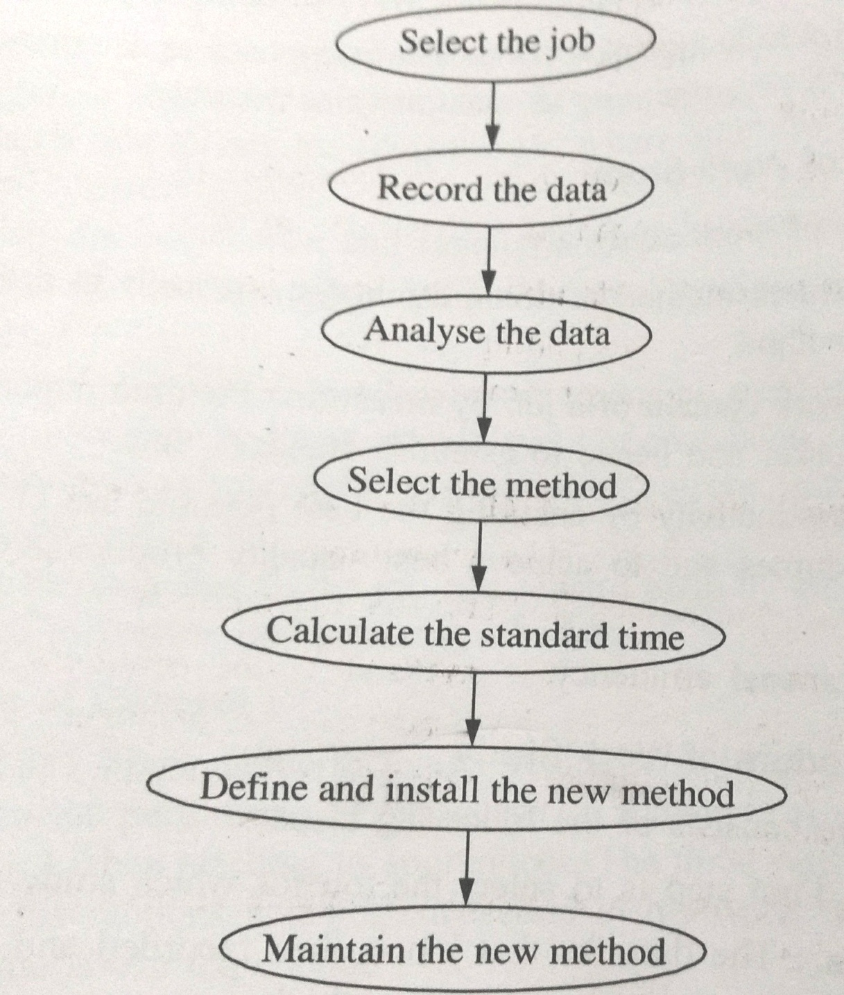

Slide 15
Components of work study:
The components of work study are
(i)Method study
(ii)Work measurement
Method Study:
Method study deals with the manner in which work is performed. The best possible method is adopted for work or improvements can be done in current methods.

Slide 16
Steps in Method Study:
(a)Select the job
(b)Recording the important facts about the
job
(c)Examine the job
(d)Developing the most economical method
(e)Evaluate various alternative methods
(f)Defining the new methods
(g)Install the new method

Slide 17
(h)Maintain the new developed method
2.Work Measurement:
Work measurement means measuring the work by establishing a time for a worker to carry out specified job at a defined level of performance.

Slide 18
Steps in Work Measurement:
(a) Select the job
(b) Record the data
(c) Examine the relevant facts
(d) Calculate the basic time
(e) Calculate the standard time
(f) Install and maintain

Slide 19
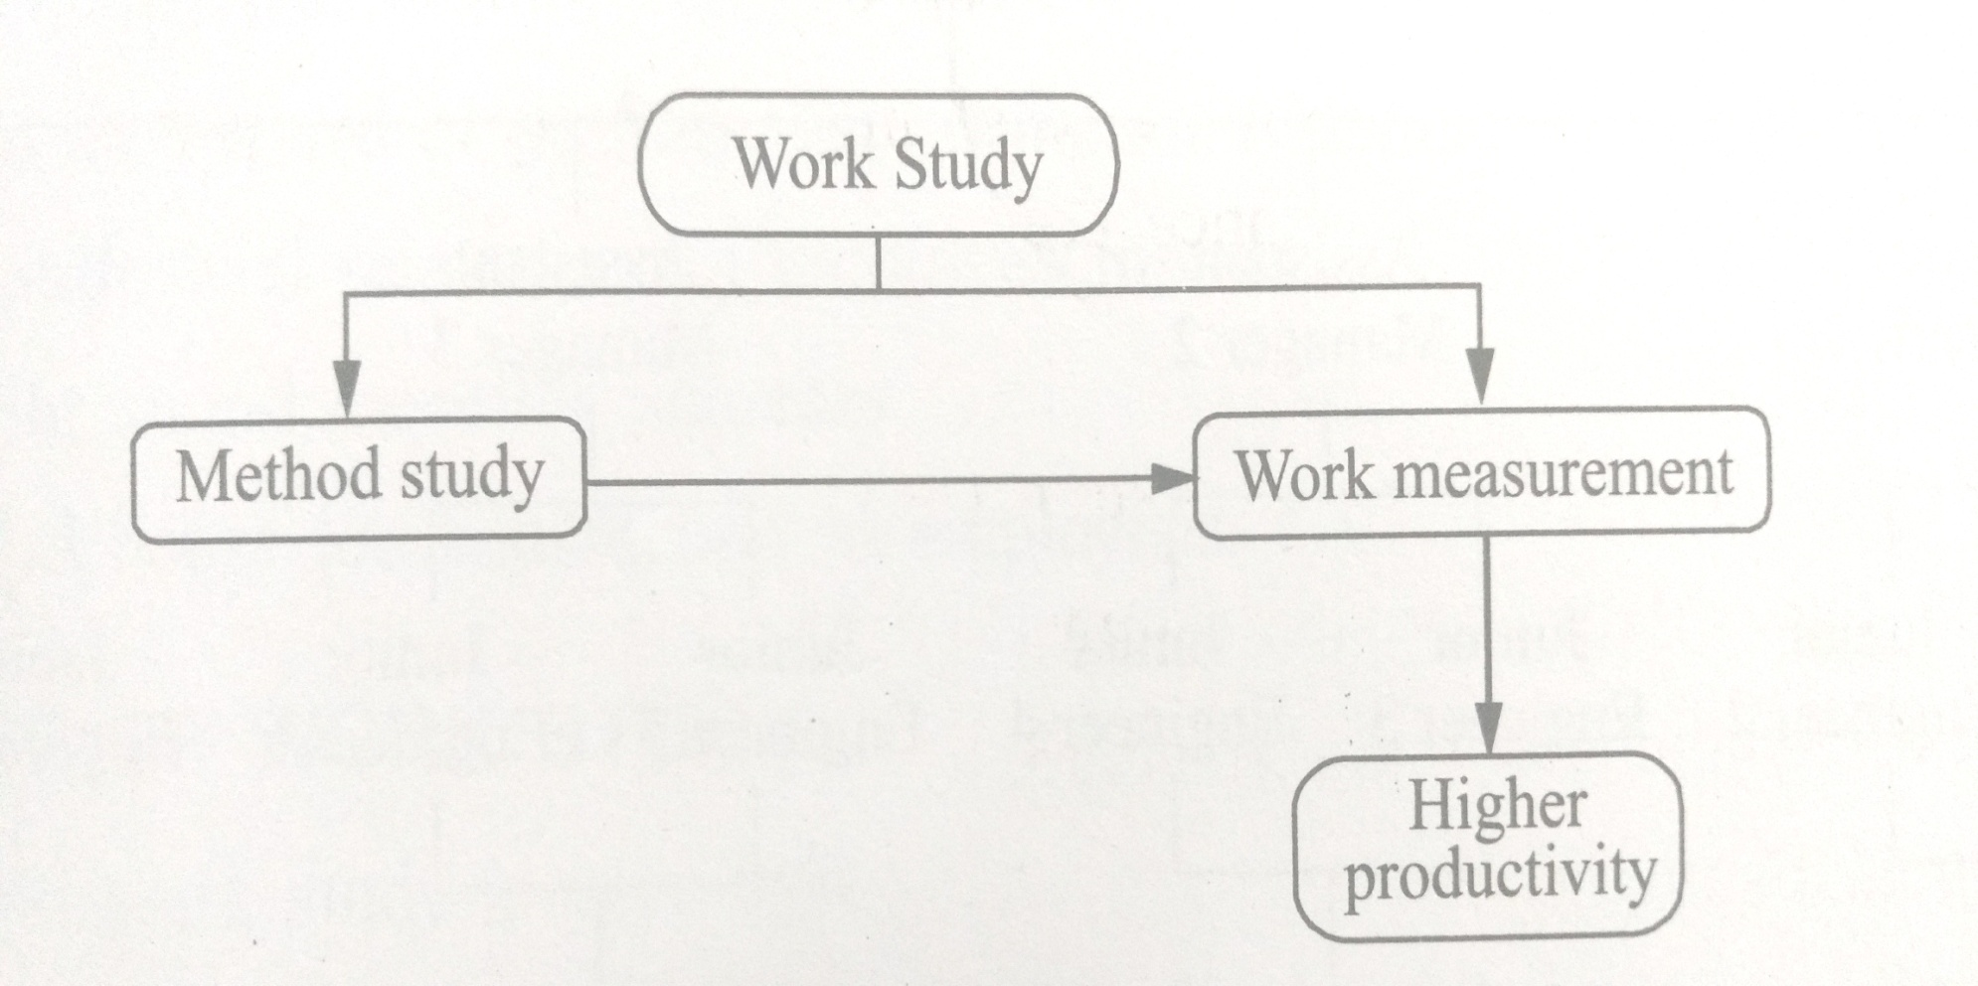

Slide 20
Inter-Relation Between Method Study And Work
Measurement:
Both method study and work measurement are associated with work study and are closely linked to each other. Method study reduces the content of job, whereas work measurement investigates and reduces ineffective time associate with job.

Slide 21
CHAPTER-3
Method Study

Slide 22
Method Study:
Method study is the systematic recording and critical examination of the present and proposed ways of doing work, as a means of developing and applying easier and more effective methods to reduce cost.

Slide 23
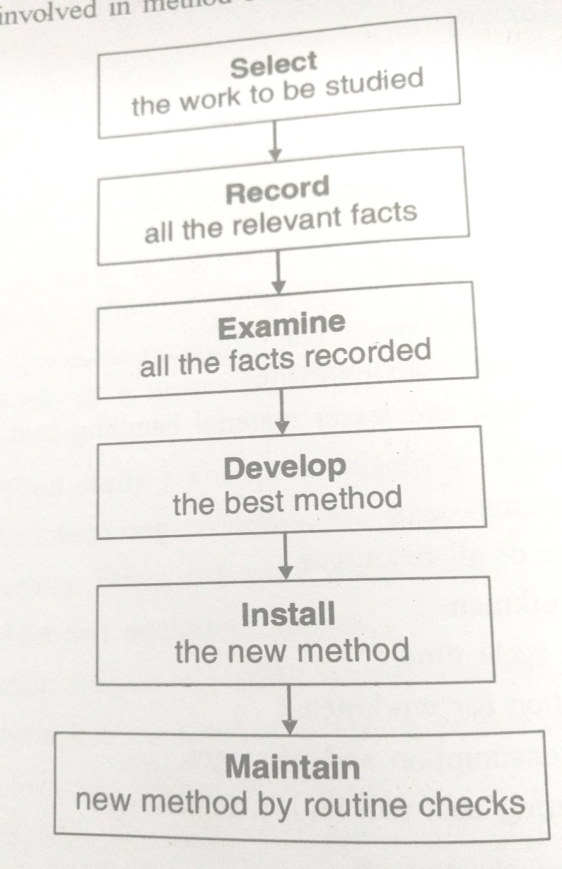
Method Study Procedure

Slide 24
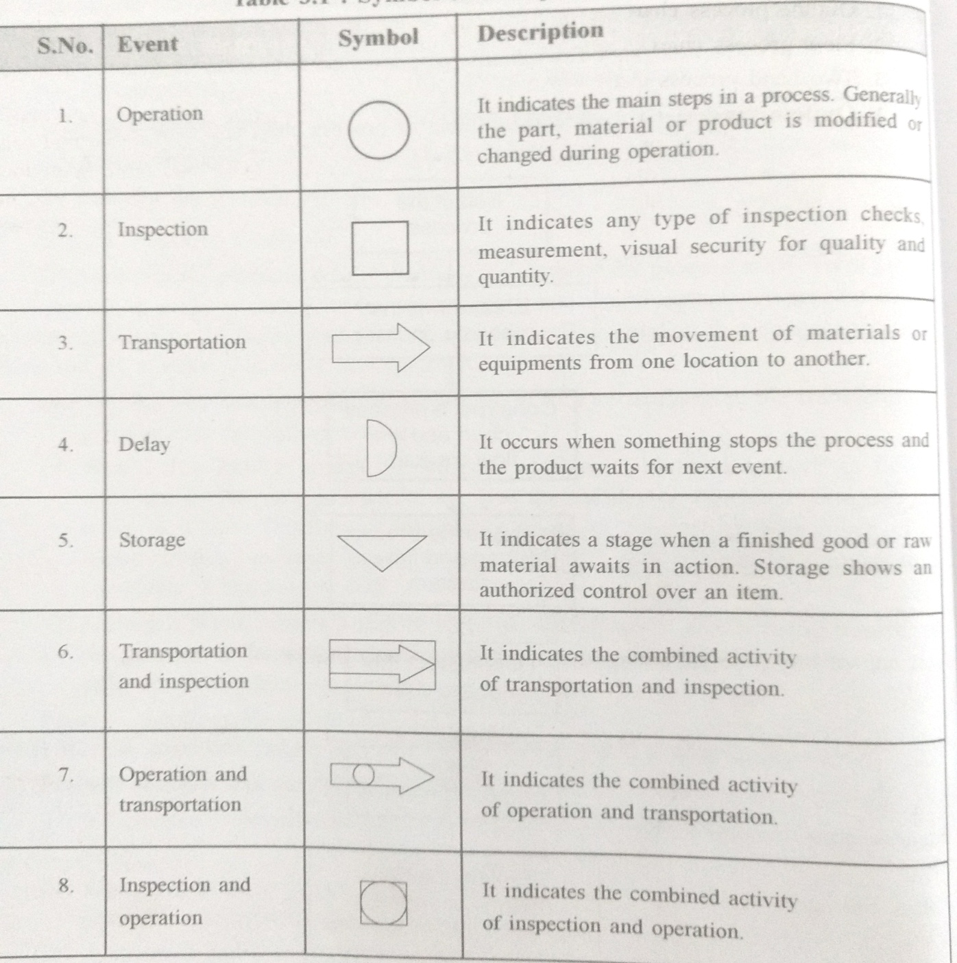
Symbol used in Process Chart

Slide 25
Process Chart:
It is a diagram which gives an overall view of the process. It helps in visualizing various possible alternations or improvements. A process chart records graphically, the operations connected with a process.
1.Outline process chart
2.Flow process chart
3.Two handed process chart

Slide 26
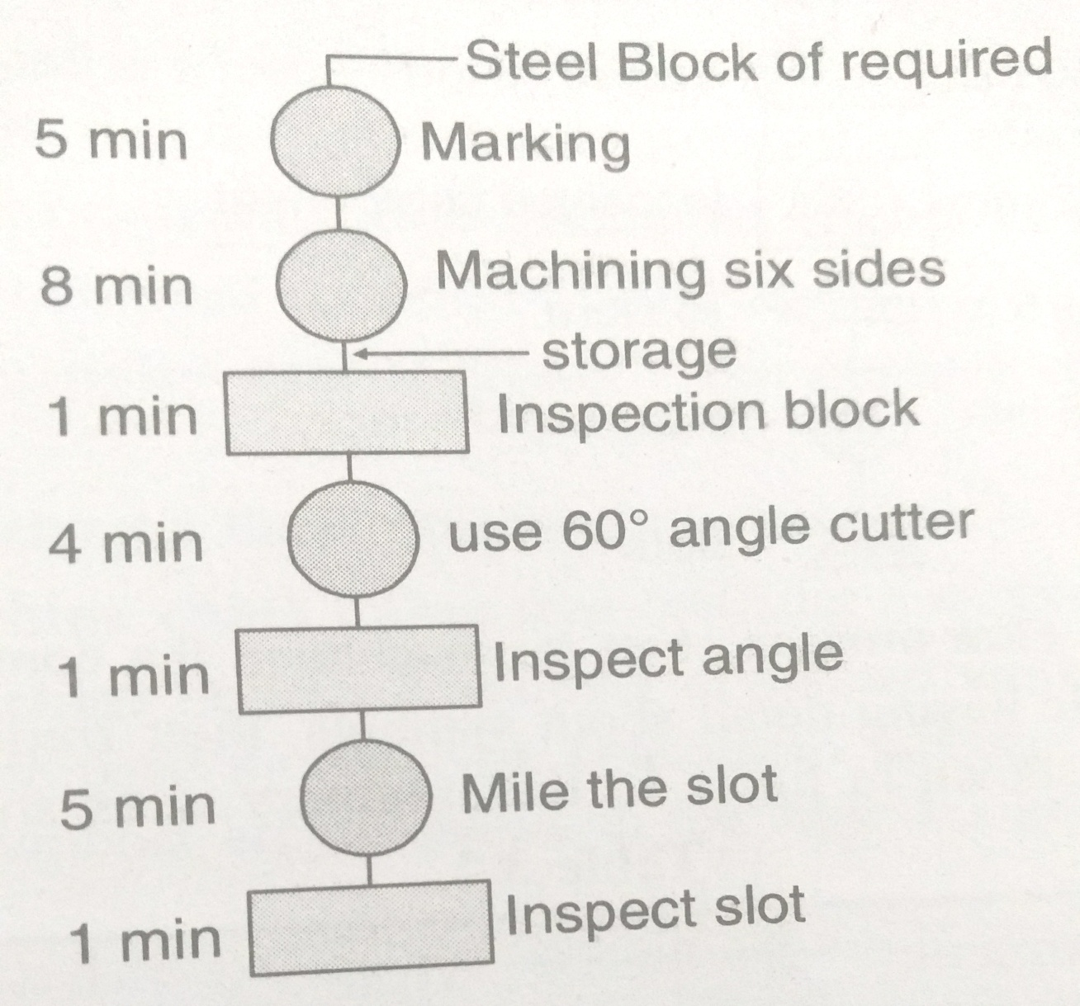
Outline Process Chart

Slide 27
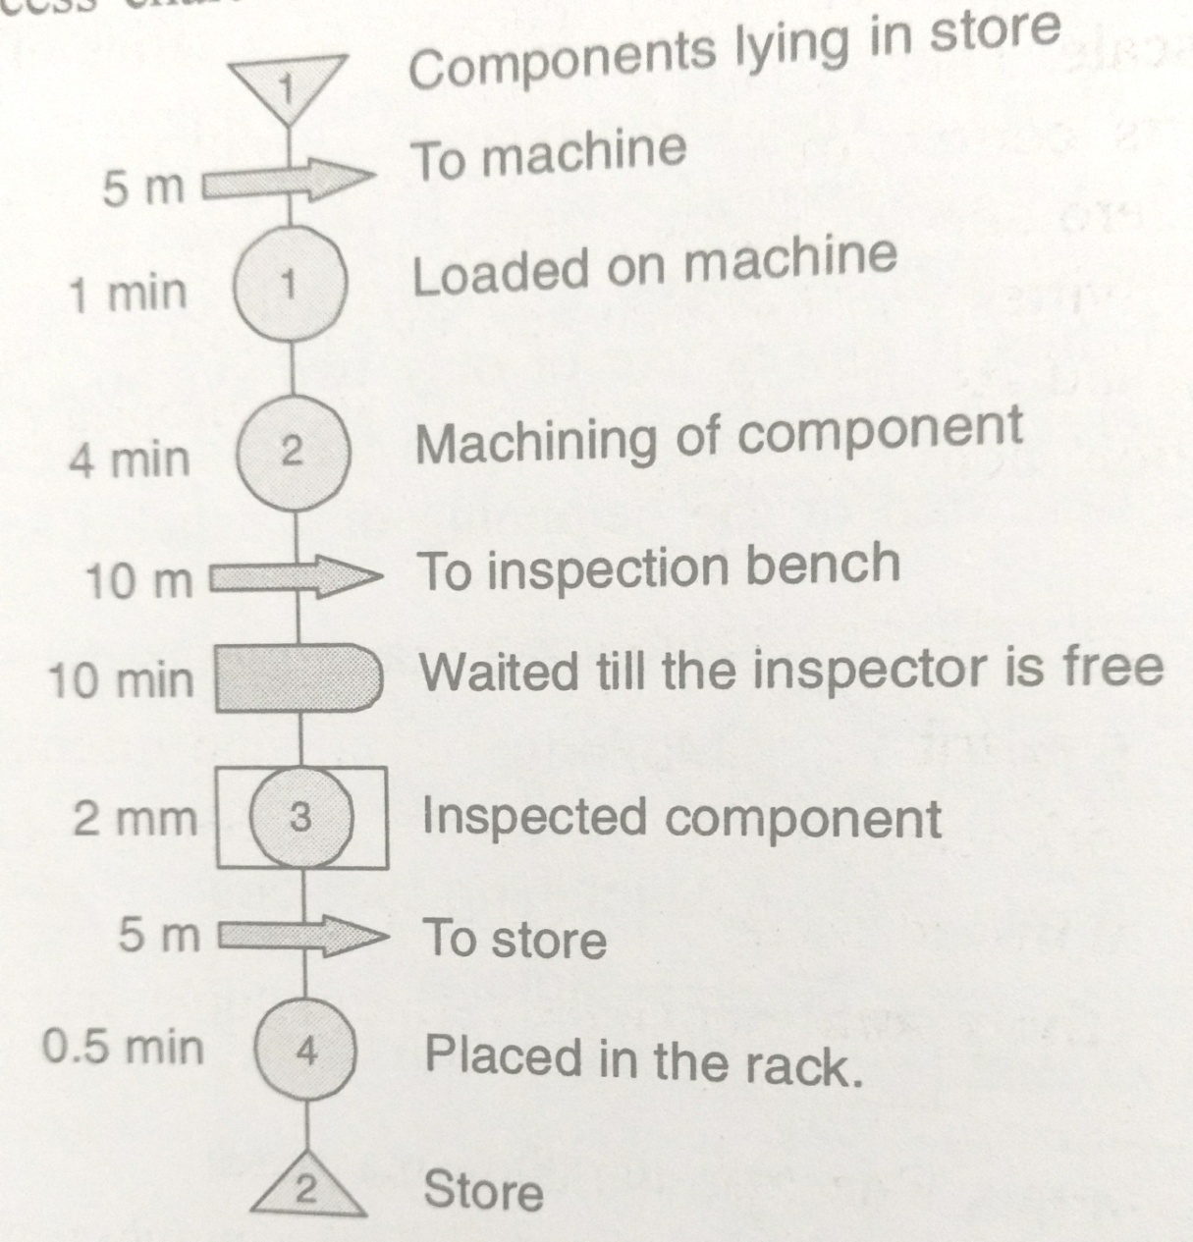
Flow Process chart

Slide 28
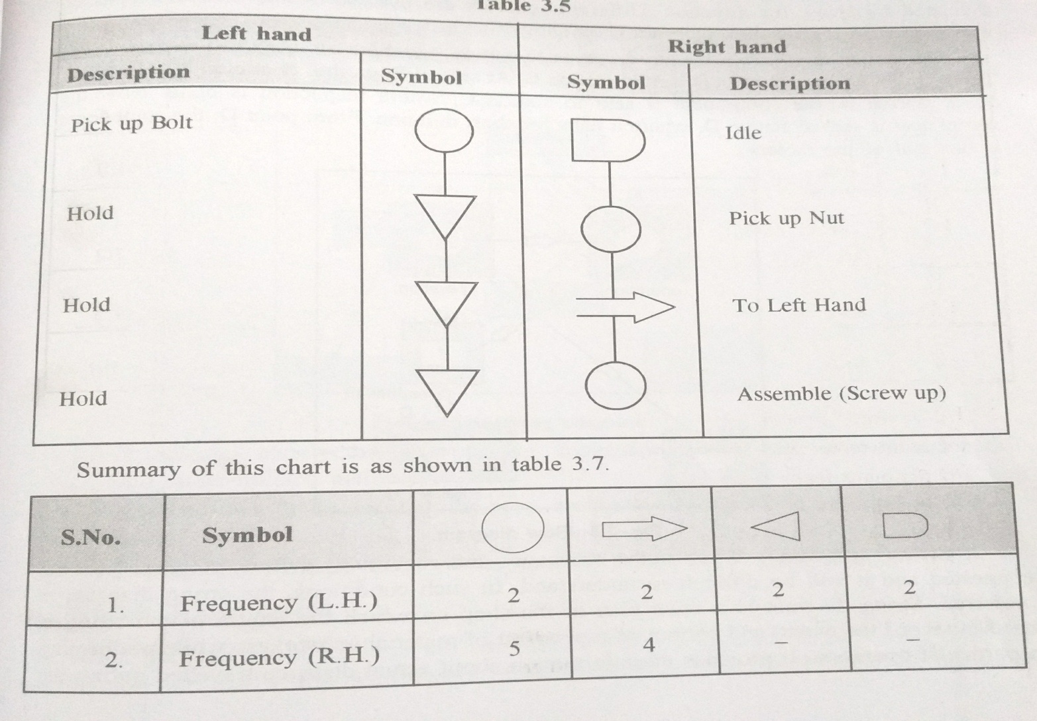
Two Handed Process Chart :

Slide 29
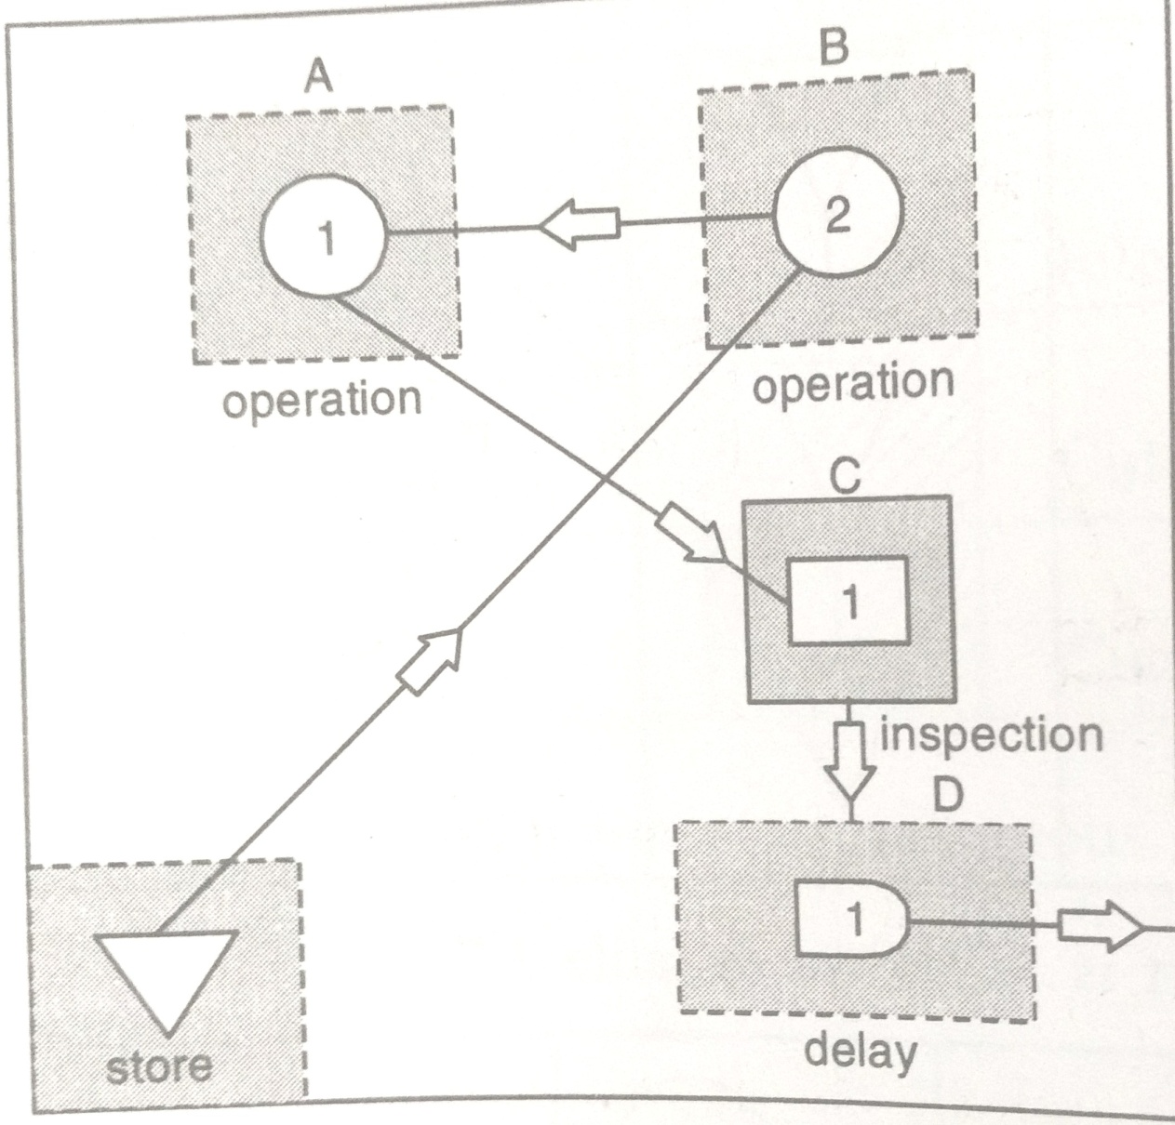
FLOW DIAGRAM:

Slide 30
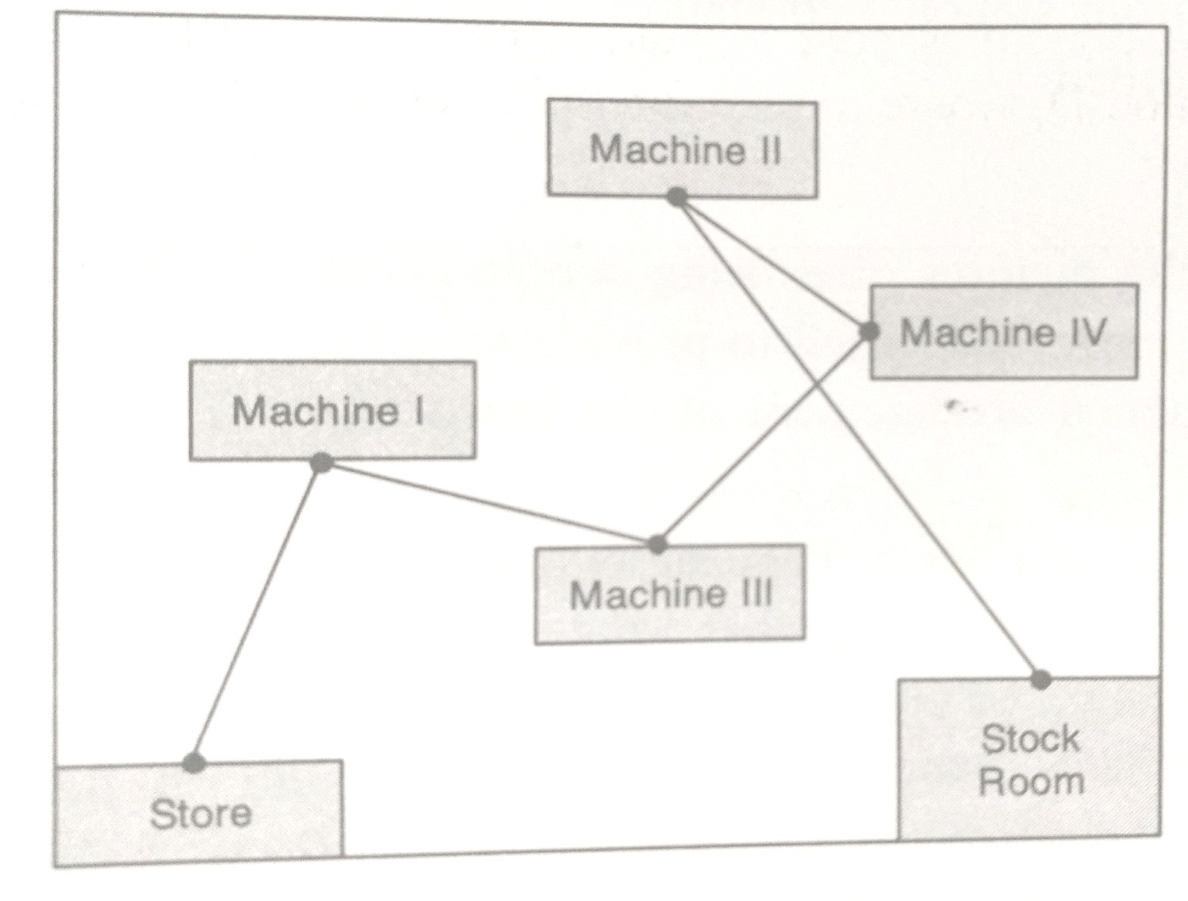
String Diagram:

Slide 32
PRODUCTION PLANNING AND
CONTROL

Slide 33
PRODUCTION PLANNING
Meaning:-
Production planning involves management decisions on the resources that the firm will require for its manufacturing operations and the selection of these resources to produce the desired goods at the appropriate time and at the least possible cost.
Definition:-
"The planning of industrial operations involves four considerations, namely, what work shall be done, how the work shall be done and lastly, when the work shall be done - kimball and kimball

Slide 34
OBJECTIVES OF PRODUCTION PLANNING
1.To determine the requirements of men, material and equipment.
2.Arranging production schedules according to the needs of
marketing demand.
3.Arranging various inputs at a right time and in right quantity.
4.Making most economical use of various inputs.
5.To achieve coordination among various departments relating
to production.
6.To make all arrangements to remove possible obstacles in the
way of smooth production.
7.To achieve economy in production cost and time.
8.To operate plant at planned level of efficiency.
9.Making efforts to achieve production targets in time.
10.Providing for adequate stocks for meeting contingencies.

Slide 35
PRODUCTION CONTROL
Meaning:-
Production control guides and directs flow of production so that products are manufactured in a best way and conform to a planned schedule and are of the right quality.Control facilitates the task of manufacturing and see that every theme goes as per the plan.
Definition:-
"Production control refers to ensuring that all which occurs is in accordance with the rules established and instructions issued.“
-HENRY FAYOL

Slide 36
OBJECTIVES OF PRODUCTION CONTROL
1.To implement production plans by issuing orders
to those who are supposed to implement them.
2.To ensure that various inputs like men, machine,
materials etc. are available in the required quantity
and quality.
3.Making efforts to adhere to the production schedules.
4.To ensure that goods are produced according to the
prescribed standards and quality norms.
5.To undertake the best and most economic production
policies.
6.To introduce a proper system of quality control.
7.To ensure rapid turnover of production and minimizing
of inventories of raw materials and finished products.

Slide 37
PRODUCTION PLANNING AND CONTROL
  Meaning:-
  Production planning and control is concerned with directing production along the lines set by the planning department.
Definition:-
"Production planning and control is the co-ordination of series of functions according to a plan which will economically utilize the plant facilities and regulate the orderly movement of goods through the entire manufacturing cycle from the procurement of all materials to the shipping of finished goods at a predetermined rate."
-CHARLES A. KOEPKE

Slide 38
CHARACTERISTICS OF
PRODUCTION PLANNING AND CONTROL
1. It is the planning and control of manufacturing process
in an enterprise.
2.Questions like-what is to be manufactured? when it is tobe manufactured? etc.
3.All types of inputs like materials,men,machines are
efficiently used for maintaining efficiency of manufacturing
process.
4.Various factors of production are integrated to use them
efficiently and economically.
5.The manufacturing process is organised in such a way
that none of the work centres is either overworked or
under worked.
6.The work is regulated from the first stage of procuring
raw materials to the stage of finished goods.

Slide 39
Need/Importance of Production Planning and Control
For Increasing Production:- The main purpose of production planning, function is to arrange various inputs like men, materials and machines and integrating them for making their best use. When various factors of production are economically used then production will certainly go up. Efforts are made to avoid production stoppages for want of various inputs. A production control Programme will minimize the idleness of men and machines.
For Co-coordinating Plant Activity: - Production planning helps in controlling plant activities. Production targets are set on the basis of sales forecasts. The raw materials, men and equipment are arranged by keeping in view production plans. Different production activities are adjusted as per the plans. If production is carried out in a number of processes then their activities are synchronized for smooth working.

Slide 40
For Cost Control: - It helps in controlling various costs. In the absence of a proper production plan, the idleness of men, material and equipment may not be noticed. Whenever performance is below standards then corrective measures are taken to rectify it. A properly planned system of production will help in controlling costs by not only making full utilization of various inputs but also by increasing output and lowering overhead expenses per unit.
For Rationalisation of Production Activities: - An important objective of production planning and control is also to regulate the flow of various inputs into the production system for running it smoothly. The system is planned in such a way that everything is done automatically. The supply of materials and men follows the demand for goods. The quality standards are followed in routine and sub-standard products are discarded in the processes. The process of entering of raw materials and converting them into finished

Slide 41
5. Consumers: - The consumer is ensured good quality goods. The process will help in raising quality standards of products. The supply of goods is also prompt and consumer has not to wait for them.Production schedules are prepared by keeping in mind the requirements of consumers. The supplies are regulated for meeting the demand for goods. The increase in production also helps the consumer in getting sufficient supply of goods.

Slide 42
Limitations of production planning and control
1. Based on Assumptions: - Production planning and control is based on certain assumptions. In case the assumptions prove correct then the planning and control will go smoothly, otherwise it may not. The assumptions generally are about plant capacity, orders, availability of raw materials and power etc. if these assumptions go wrong then the process of planning and control will go weak.
2. Rigidity: - Under production planning and control the things are pre-decided and fixed. There is rigidity in the behavior of employees and it may not help in smoothening the flow of work.
3. Difficult for Small Firms: - This process is time consuming and small firms may not be able to make use of production planning and control.
4. Costly: - It is a costly device as its implementation requires separate persons to perform the functions of planning, dispatching, expediting etc. Small firms cannot use the services of specialists due to cost factor.

Slide 43
5. Dependence on External Factors: - The external factors sometimes reduce the effectiveness of production planning and control. The factors like natural calamities, change in technology, change in fashion, breakdown of power, government controls etc. limit the use of production planning and control.
Techniques or Elements of Production Planning and Control
The following are the techniques of production planning and control:
A. Planning B.Routing
C. Scheduling D. Dispatching
E. Follow-up and Expediting F. Inspection

Slide 44
Planning
It is the first element of production planning and control. Planning is given an important role in every business. A separate department is set up for this work. Planning is deciding in advance what is to done in future. Control devices are also decided in advance so that all activities are carried on properly. An organizational set up is created to prepare plans and policies. Various charts, manuals and production budgets are also prepared. If production planning is defective then control will also be defective. Planning provides a sound base for control.
Routing
It is determining the exact path or routing which will be followed in production. The stages from which goods are to pass are decided after a proper thought. Routing may be compared to a train journey for reaching a particular place. If a passenger is to reach Delhi from Ambala Cantt then he has the option of going via Panipat and via Saharanpur. Both the routes will take him to Delhi. The question is – which route will be economical in time and money? The passenger will decide the route only after taking into consideration various factors affecting his journey. Similar is the case with production routing. It is the selection of the path from where each unit has to pass before reaching the final stage. The path must have the best and cheapest sequence of operations.

Slide 45
Routing Procedure:-
Deciding what part to be made or purchased: - The product is thoroughly analyzed to find out which parts are required for it. The second decision is taken regarding the production or purchase of various components. Some components may be manufactured by the firm and others may be procured from the market. During slack periods most of the components may be manufactured by the firm but when industrial activity is at its peak then supplies from outside may be contracted.
Determining Materials Required: - The analysis of the product will enable us to know the type of materials required for producing various components. The right type of quality, quantity, and time when needed should also be decided in advance.

Slide 46
Determining Manufacturing Operations and Sequences: - The manufacturing operations and their sequences can be determined from technical experience and layout of machines. A sound and economical operation is selected for manufacturing various components.
Determining of Lot Sizes: - A decision has to be taken about the number of units to be produced in one lot. If production is carried on the basis of orders then size of the lot depends upon the quantity ordered plus some units for possible rejections during the process.

Slide 47
Determining of Scrap Factors: - There may be some scrap during the course of manufacture. The finished products are generally less then the units introduced at the beginning. The scrap during manufacturing should be anticipated so that routing is facilitated. If products pass through three processes and a normal scrap is 5% of input at every stage then it will be easy to anticipate the units entering various processes and arrange equipments, and manpower

Slide 48
Analysis of Cost of the Product: - The determination of cost of products may be the duty of department but still production department makes records of direct materials, labour, direct and indirect expenses. These estimates are greatly useful to costing department also.
Preparation of Production Control Forms: - The carrying out of routing will be facilitated if forms are prepared to collect information for control purpose. The requirements are: job cards, inspection cards, move tickets, labour cards, tool tickets, etc.

Slide 49
SCHEDULING
Scheduling is the determining of time and date when each operation is to be commenced and completed. it includes the scheduling of materials, machines and all other requisites of production.
Scheduling means" fitting specific jobs into a general time table so that order may be manufactured in accordance with contracted liability or in mass production, so that each component may arrive at and enter into assembly in the order and as is required."
-ALFORD AND BEATY

Slide 50
Types of schedules
Master scheduling: Scheduling starts with the master schedule. this schedule is prepared by keeping in view the order or likely sales order in near future. Master scheduling is the break up of production requirements. This may be prepared for a week, a fortnight, a month etc. No definite pattern may be suggested for master schedules because these may differ from industry to industry.
Operation scheduling: Manufacturing or operation scheduling is used where production process is continuous. when same product is produced repeatedly or comparatively small number of products are required then operation schedules are useful. the name and number of the product and the quantity to be produced in a given time are required to prepare a manufacturing schedule.
Detail operation scheduling: It indicated the time required to perform each and every detailed operations of a given machine or process.

Slide 51
DESPATCHING
The term dispatching refers to the process of actually ordering the work to be done. It involves putting the plan into effect by issuing orders. it is concerned with starting the process and operation on the basis of route sheets and schedule charts.
"Dispatches put production in effect by releasing and guiding manufacturing order in the sequence previously determined by route sheets and schedule.”

Slide 52
PROCEDURE:
1.Moving of materials from process to process.
2.Assigning of work to machines.
3.Issuing of tools to production departments.
4.Issuing of job orders.
5.Recording of time taken.
6.Ensuring necessary changes.
7.Having proper liaison with routing

Slide 53
IMPORTANT DOCUMENTS
1.Material requisitions
2.work order
3.control sheet
4.Internal delivery note
5.Tool and gauge ticket

Slide 54
FOLLOW UP AND EXPDITING
Follow up or expediting is that branch of production control procedure which regulates the progress of materials and part through the production process".
PROCEDURE:
1.Progress should be checked
2.Causes of differences should be ascertained
3.Helping in removing the deviations
4.Report with departments supplying materials.

Slide 55
INSPECTION
Inspection is also an important function of control. the purpose of inspection is to see whether the products manufactured are of requisite quality or not. It is carried on at various levels of production process so that pre-determined standards of quality are achieved. Inspection is undertaken both of products and inputs.

Slide 56
ESTIMATION
Estimation is the scientific way of working out the approximate cost of an engineering project before execution of the work.
It is totally different from calculation of the exact cost after completion of the project.
Estimation requires a thorough Knowledge of the construction procedures and cost of materials & labour in addition to the skill , experience, foresight and good judgment.

Slide 57
ESTIMATE
An estimate of the cost of a construction job is the probable cost of that job as computed from plans and specifications.
For a good estimate the, actual cost of the proposed work after completion should not differ by more then 5 to 10 % from its approximate cost estimate, provided there are no unusual, unforeseen circumstances.

Slide 58
NEED FOR ESTIMATE
1. It help to work out the approximate cost of the project in order to decide its feasibility with respect to the cost and to ensure the financial resources, it the proposal is approved.
2. Requirements of controlled materials, such as cement and steel can be estimated for making applications to the controlling authorities.
3. It is used for framing the tenders for the works and to check contractor’s work during and after the its execution for the purpose of making payments to the contractor.
4. From quantities of different items of work calculated in detailed estimation, resources are allocated to different activities of the project and ultimately their durations and whole planning and scheduling of the project is carried out.

Slide 59
SITE CONDITIONS AFFECTING THE OVERALL COST
1 = Each type of work requires a different method of construction. Construction may be of an ordinary house or office and it may also be of a Dam, Tunnel, Multistory building, Airport, Bridge, or a Road, already in operation. Each of these works requires totally different construction techniques, type of machinery, and formwork.
2 = Quality of labour and labour output varies in different localities.
3 = Weather conditions greatly affect the output and, hence, the overall cost.

Slide 60
SITE CONDITIONS AFFECTING THE OVERALL COST (-ctd-)
4. Ground conditions vary and change the method of construction. For example, excavation may be dry, wet, hard, soft, shallow or deep requiring different efforts.
5. The work may be in open ground such as fields or it may be in congested areas such as near or on the public roads, necessitating extensive watching, lightening, and controlling efforts, etc.

Slide 61
SITE CONDITIONS AFFECTING THE OVERALL COST (-ctd-)
6. The source of availability of a sufficient supply of materials of good quality is also a factor.
7. The availability of construction machinery also affects the method of construction.
8. Access to the site must be reasonable. If the access is poor, temporary roads may be constructed.

Slide 62
ESSENTIAL QUALITIES OF A GOOD ESTIMATOR
In preparing an estimate, the Estimator must have good knowledge regarding the important rules of quantity surveying.
He must thoroughly understand the drawings of the structure, for which he is going to prepare an estimate.
He must also be clearly informed about the specifications showing nature and classes of works and the materials to be used because the rates at which various types of works can be executed depend upon its specifications.

